Slide 1

POWER POINT PRESENTATION On PROJECT – “Phishing URL Detection” DEPARTMENT OF COMPUTER SCIENCE & ENGINEERING
Presented By:
Project Group (B.Tech CSE )
Miss. Anamika Dhananjay Gulumkar(2003)
Miss. Harshada Dattatray Jadhav(2017)
Miss. Sakshi Chandrashekar Shinde(2035)
Mr. Shridhar Prakash Aware(2042)
Guided By:
Guide Name:- Mr. Pathak P.A.
Designation:- Assistant Professor
College Name:- Arvind Gavali College Of Engineering , Satara

Slide 2
CONTENTS
INTRODUCTION
PROBLEM STATEMENT
OBJECTIVES OF THE PROPOSED WORK
LITERATURE REVIEW
METHODOLOGY
HARDWARE REQUIREMENTS
SOFTWARE REQUIREMENTS
RESULTS & DISCUSSIONS
CONCLUSIONS
FUTURE SCOPE
REFERENCES
PROGRAM OUTCOMES
COURSE OUTCOMES
CO-PO MAPPING

Slide 3
INTRODUCTION
Phishing has become the most serious problem, harming individuals, corporations, and even entire countries.
The availability of multiple services such as online banking, entertainment, education, software downloading, and social networking has accelerated Web's evolution in recent years.
Spoofed emails pretending to be from reputable businesses and agencies are used in social engineering techniques to direct consumers to fake websites that deceive users into giving financial information such as usernames and passwords.
Technical tricks involve the installation of malicious software on computers to steal credentials directly, with systems frequently used to intercept users' online account usernames and passwords.

Slide 4
PROBLEM STATEMENT
The major trouble is that phishing technique is bad accuracy and low adaptability to new phishing links.
Detecting suspicious websites and detecting if they are phishing or not?

Slide 5
OBJECTIVE
Machine Learning is an effective method for detecting phishing.
It also eliminates the disadvantages of the previous method.
We conducted a thorough review of the literature and suggested a new method for detecting phishing websites using features extraction and a machine learning algorithm.
The project's goal is to detect phishing URLs and narrow down the best machine learning algorithm by evaluating each algorithm's accuracy rate, false positive rate, and false negative rate.

Slide 6
LITERATURE SURVAY
Author name | Paper name | Publication Year | Important Points
^{Prof. Shilpa Hadkar} | “Intelligent phishing URL detection using association rule mining” | 2022 | Aim of the paper is to detect phishing URLs as well as narrow down to best machine learning algorithm by comparing accuracy rate, false positive and false negative rate of each algorithm.
S.M. Mohammed Nazim Feroz | “Phishing URL detection using URL ranking” | 2019 | Aim of the phishers is to acquire critical information like username, password and bank account details. Cyber security persons are now looking for trustworthy and steady detection techniques for phishing websites detection.
Rishikesh Mahajan | “Phishing Website Detection using Machine Learning Algorithms” | 2018 | This paper deals with machine learning technology for detection of phishing URLs by extracting and analyzing various features of legitimate and phishing URLs. Decision Tree, random forest and Support vector machine algorithms are used to detect phishing websites.

Slide 7
EXISTING SYSTEM
Data Collection and Feature Extraction:
Gather a diverse dataset containing both legitimate and phishing websites.
Extract relevant features from the URLs, website content, and metadata.
Features may include URL length, presence of suspicious keywords, domain age, SSL certificate information, etc.
Model Selection and Training:
Choose appropriate machine learning algorithms for classification tasks, such as decision trees, random forests, support vector machines (SVM), or neural networks.
Split the dataset into training and testing sets for model evaluation.
Train the selected models using the training data, optimizing hyperparameters to improve performance.
Real-Time Monitoring and Detection:
Implement the trained models into a real-time monitoring system.
Continuously monitor incoming URLs or website requests.
Apply the trained models to classify URLs as either legitimate or phishing in real-time.
Use techniques like streaming analytics or event processing to handle large volumes of data efficiently.

Slide 8
METHODOLOGY
A phishing website is a social engineering technique that imitates legitimate
webpages and uniform resource locators (URLs).
The Uniform Resource Locator (URL) is the most common way for phishing assaults to occur.
Phisher has complete control over the URL's sub-domains. The phisher can alter the URL because it contains file components and directories.This research used the linear-sequential model, often known as the waterfall model.
Although the waterfall approach is considered conventional, it works best in instances where there are few requirements. The application was divided into smaller components that were built using frameworks and hand-written code.

Slide 9
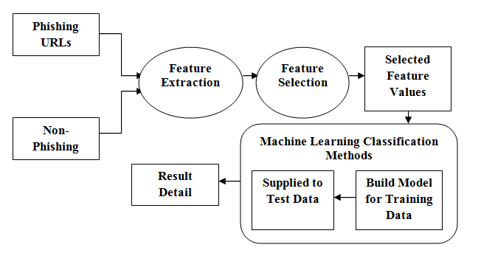
BLOCK DIAGRAM

Slide 10
HARDWARE AND SOFTWARE REQUIREMENTS
Hardware Required -
Server :
8 GB RAM
512 GB of SSD
Windows 11
Client :
8 GB RAM
100 GB of SSD
Windows 11

Slide 11
Software Requirement -
Development :
Anaconda Navigator
Data Set
Python 2.7
Libraries :
Pandas
Numpy
Sklearn

Slide 12
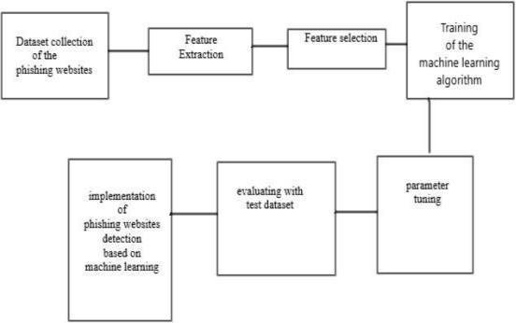
FLOWCHART DIAGRAM

Slide 13
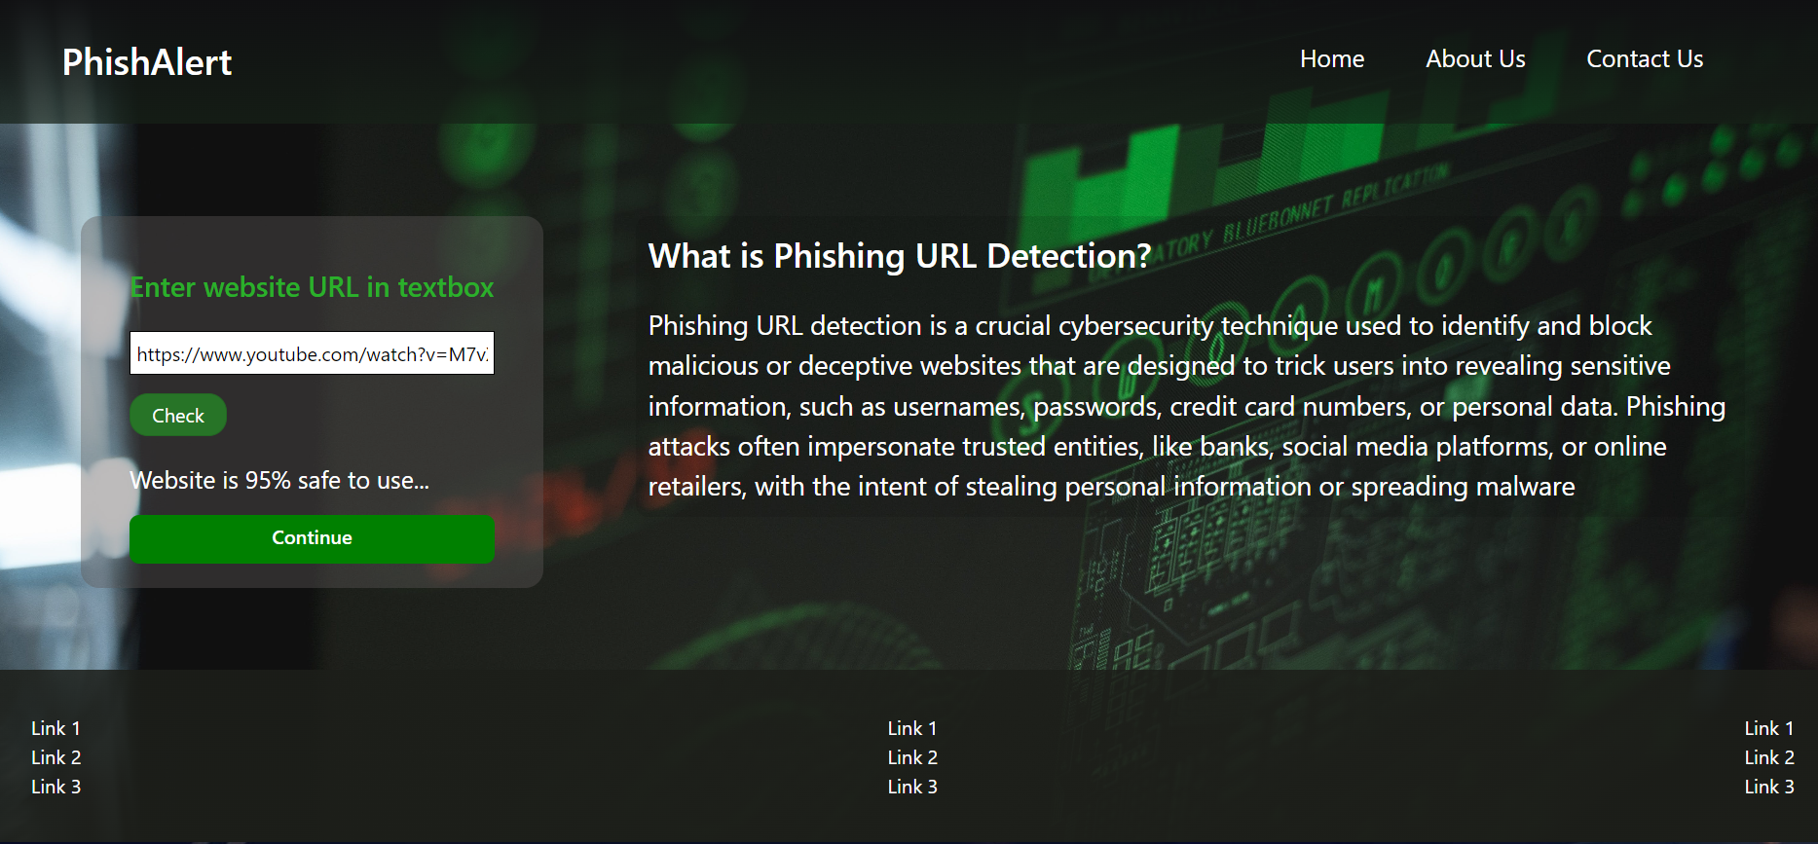
RESULT

Slide 14
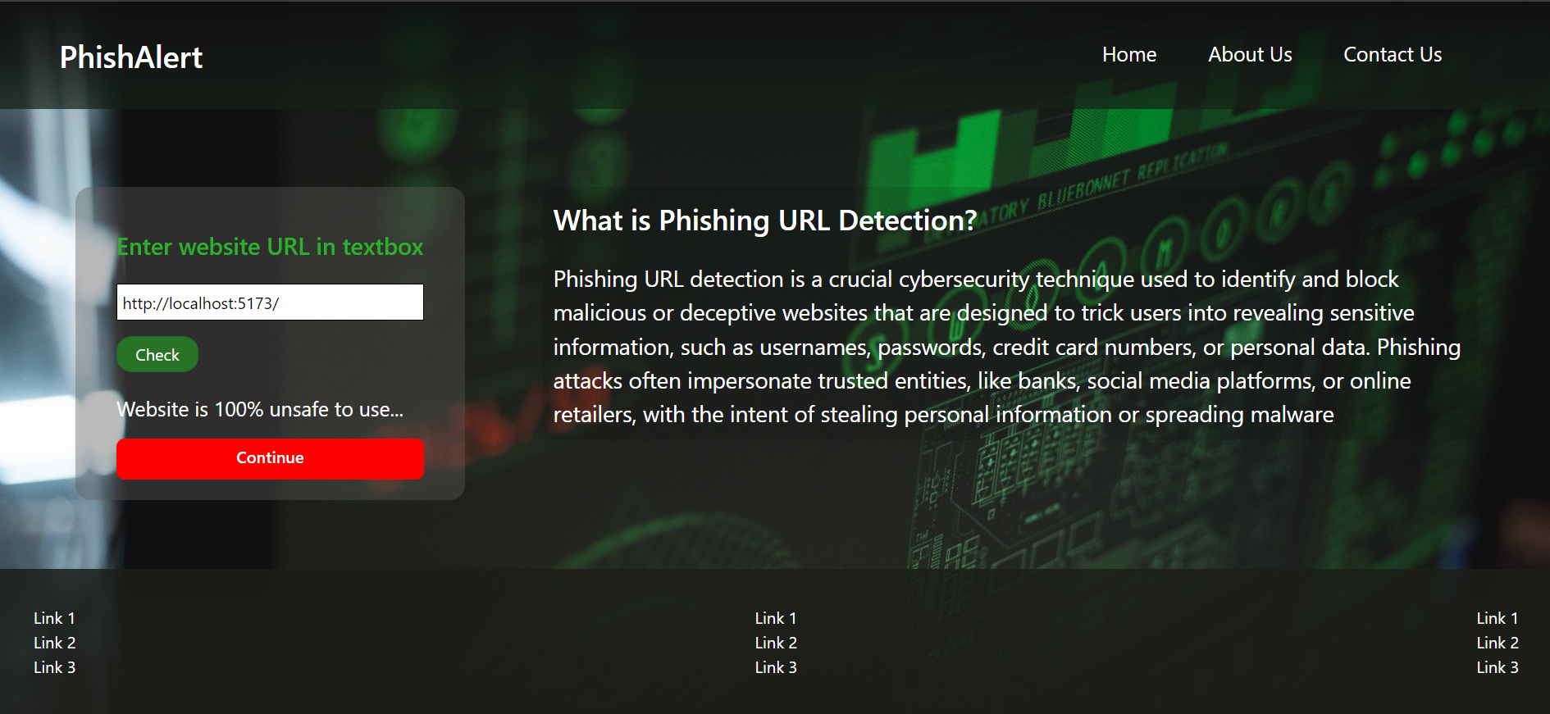

Slide 15
CONCLUSIONS
This survey presented various algorithms and approaches to detect phishing websites by several researchers in Machine Learning.
On reviewing the papers, we came to a conclusion that most of the work done by using familiar machine learning algorithms like Naïve Bayesian, SVM, Decision Tree and Random Forest.Some authors proposed a new system like Phish Score and Phish Checker for detection.
The combinations of features with regards to accuracy, precision, recall etc. were used. Experimentally successful techniques in detecting phishing website URLs were summarized.
As phishing websites increases day by day, some features may be included or replaced with new ones to detect them.

Slide 16
FUTURE SCOPE
In future if we get structured dataset of phishing we can perform phishing detection much more faster than any other technique.
In future we can use a combination of any other two or more classifier to get maximum accuracy.
We also plan to explore various phishing techniques that uses Lexical features, Network based features, Content based features, Webpage based features and HTML and JavaScript features of web pages which can improve the performance of the system.
In particular, we extract features from URLs and pass it through the various classifiers.

Slide 17
REFERENCES
[1] Lakshmanarao, A., Rao, P.S.P., Krishna, M.M.B. (2021) ‘Phishing website
detection using novel machine learning fusion approach’, in 2021 International
Conference on Artificial Intelligence and Smart Systems (ICAIS), Presented at the
2021 International Conference on Artificial Intelligence and Smart Systems (ICAIS),
1164–1169
[2] H. Chapla, R. Kotak and M. Joiser, "A Machine Learning Approach for URL
Based Web Phishing Using Fuzzy Logic as Classifier", 2019 International Conference
on Communication and Electronics Systems (ICCES), pp. 383-388, 2019, July
[3] 14 Types of Phishing Attacks That IT Administrators Should Watch For [online]
(2021)https://www.blog.syscloud.com,available:https://www.blog.syscloud.comtypes-o
f-phishing/
Websites :
https://github.com/suhas-005
https://nthu-datalab.github.io/ml/labs/03_Decision-Trees_RandomForest/03_Decis

Slide 18

PROGRAM OUTCOMES

Slide 19
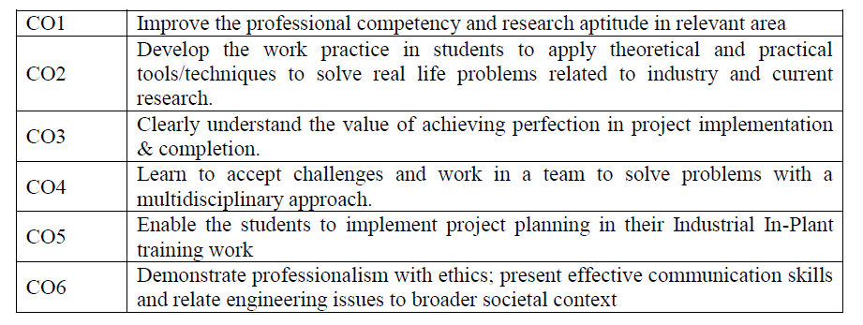
COURCE OUTCOMES OF PROJECT

Slide 20
CO-PO MAPPING OF PROJECT
 | PO 1 | PO 2 | PO 3 | PO 4 | PO 5 | PO 6 | PO 7 | PO 8 | PO 9 | PO 10 | PO 11 | PO 12
CO 1 | 3 | 3 | 2 | 3 | 2 | 3 | 3 | 2 | 2 | 3 | 3 | 2
CO 2 | 1 |  | 3 | 3 | 3 | 2 |  |  | 3 |  | 2
CO 3 | 2 | 2 | 3 |  |  |  |  | 3 | 3 |  | 3 | 3
CO 4 | 1 | 3 | 3 |  | 2 |  |  |  | 3 | 3 | 3 | 2
CO 5 | 3 | 3 | 3 | 3 | 3 | 3 | 3 | 2 | 3 | 3 | 3 | 3
CO 6 | 2 | 3 | 1 |  | 3 |  |  |  | 3 | 2 |  | 3
Strength of Correlation: High: 3 Medium: 2 Low: 1

Slide 21


